Slide 1

Enterprise Analytics Data → Information → Insights

Slide 2
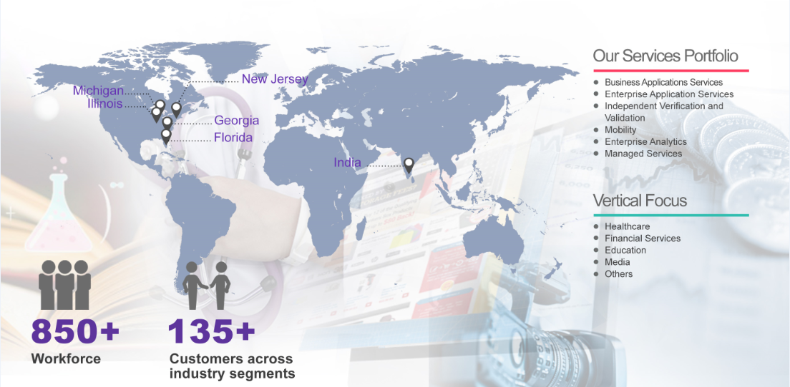
Corporate Information

Slide 3
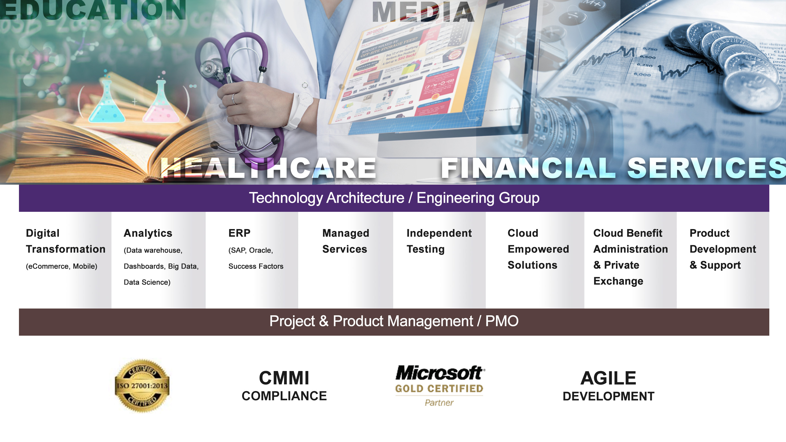
Our Services

Slide 4








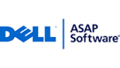















Our Representative Clientele

Slide 5
















Certifications and Partnership
Certified
Compliant
Compliant
SEI - CMMI Model Compliance
Version 3.0
Compliant
Audited
Compliant

Slide 6
Enterprise Analytics - Focus Areas
Enterprise Data Management
Big Data
Business
Insights
Data Science
Data Quality Management
Data Migration
Multi-Dimensional Data modelling
Extraction, Transformation & Loading, ODS and Data Marts
Interpretation and analysis of structured and semi-structured data
Real time data streaming from IOT devices
Data curation, storage, transfer, visualization and data fishing
Publish Insights from raw data
Real time and Aggregated data in the form of CUBES
Configurable Dash boards and Adhoc Query Builder and Adhoc Reporting
Quantitative and Behavioural Modelling,
Predictive, Prescriptive and Cognitive Analytics
Machine Learning, Forecasting & Optimization

Slide 7












Data warehouse, Visual Reporting & Dashboard Solutions
Data Modeling & ETL
Visual Reporting & Dashboard

Slide 8











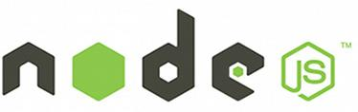









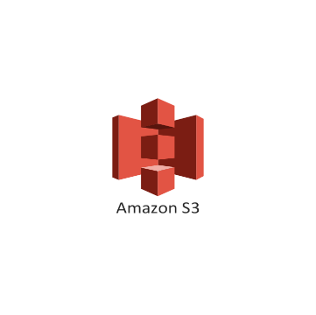
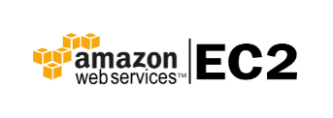






Big Data Ecosystem –Technologies
Platforms
Languages
Visualizations
Database / Data Warehousing
Complex Event Processing
Infrastructure
Data Science / Business Intelligence

Slide 9





















Big Data Engineering Landscape
Social Data
Structured
Text Analysis
Sentiment
Interests
Visualize
Predictive
Intent
Topics
Banking
Entities
Business Analytics
Enterprise Data
Big Data Infrastructure
Data Interpretation
Retail
INGEST
Media
Business Logic
Prescriptive
Dictionaries
Taxonomies
Device Data
Unstructured
Data Transformation
Data Governance and Data Security

Slide 10
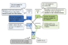
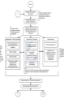
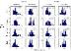
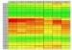
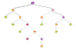
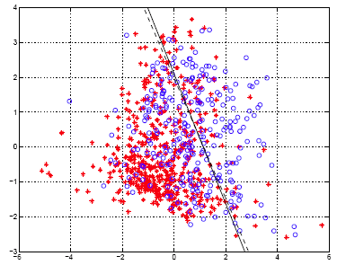
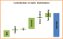
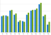
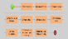

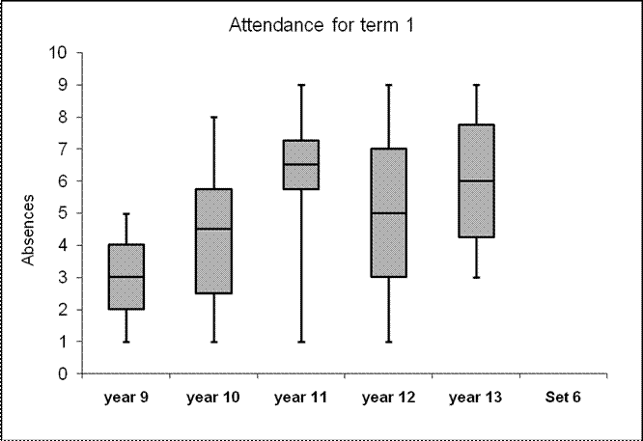
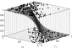
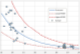

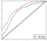

Data Science - Predictive and Prescriptive Analytics
Design Workbench
Identify business issues
Scope out project / PoC
Frame the analytic problem
Recommend tools/technologies
Discovery Engine
Facilitate data discovery
and Data diagnostics
Identify key drivers
High level solution framework
Model training and validation
Select final robust solution
Solution Toolkit
Value Realization
Value realization through predictive analytics
Build data Products
Dashboard capabilities

Slide 11
Predictive Models for Battery Failure – Business Case
Design Bench
Discovery Engine
Solution Toolkit
Value Realization
Business Problem
Identification of failed cases( Time instance & battery type).
Predicting the propensity for failure.
Inferential Exploration
Following the conductance trail.
Exploratory analysis using an aggregating metric.
Identification of trends pointing to the problem.
Introduction of other variables like voltage and current.
Establishing relationship between conductance and voltage.
Intuition for feature engineering.
Feature Engineering
Introduction of new features related to voltage and conductance
Feature transformation
Preparation of training, validation and test sets
Outcome
Agility in response
Optimized Cost of maintenance
Reduction in down time
Customer satisfaction
Levers & Data Points
Data Points
Conductance
Discharge voltage
Discharge current
Terminal voltage
Temperature
Model
Massaging the data points into data frames for analysis.
Modelling
Initial unsupervised model for validating the feature space.
Spot check of the ML model
Training the model
Model evaluation ,fine tuning and deployment of the model

Slide 12
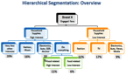
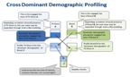
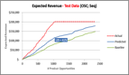
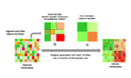
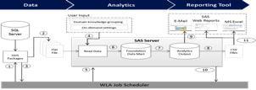
Data Science – Execution Methodology
Business Opportunity Assessment ~(2 to 4 weeks)
Understand the analytical opportunity, requirements, business context, define scope
Identify business metrics, develop hypotheses & preliminary solution approach
Identify suitable data sources, initial data exploration
Recommend a project plan
Pilot Solution Development ~(6 to 8 weeks)
Identify a subset of data / products / customers for the pilot
Preparation of training and test datasets & feature engineering
Predictive/Inferential modeling and model fine tuning
Prepare a detailed report on the findings, recommendation for enterprise-wide solution
Business Value Realization ~(2 to 4 months)
Evangelize the solution with stakeholders to agree on the expected business value
Integrate the solution with client’s existing infrastructure and stress test the solution
Monitor and track key performance metrics and evangelize the business benefits
Ongoing maintenance of solution to reflect ever changing business requirements

Slide 13
Highly Qualified and Engaged Team
Data Scientists
Design the solution approach
Business Consultants
Work with key client stakeholders to understand business context
Translate the above into an analytical problem, working with the global team
Big Data Engineers
Help architect the Big Data roadmap and architecture
Derive actionable insights from data science models
Identify the right algorithms and technologies. Skilled in R, Python, SAS, etc.
Bring in the relevant domain context
Implement Big Data pilots on different technologies
Productionize solutions
Business Intelligence Specialists
Identify KPIs (key performance indicators) and business drivers
Design & develop visualization using tools like Tableau, Cognos, Microstrategy, etc.
Leverage expertise in SQL & RDBMS technologies
Certified in Cognos, IBM Watson

Slide 14


Slide 15
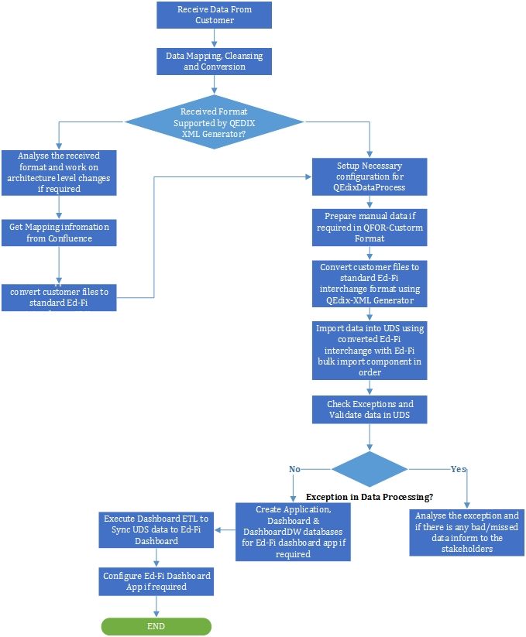
Enterprise Data Management – Empowered Solutions
Empowered Solutions is a cloud platform from Quadrant 4 that provides Instruction Learning and Assessment and Actionable Insights to school districts
Extraction of data from various sources – attendance, Student Information, Finance, HR, Learning Tools
Data Cleansing, Validation and Conversion
Aggregation and Loading of data into ODS, RDS and Dashboard

Slide 16
Enterprise Data Management – American Apparel
Large manufacturer, distributor and retailer of branded fashion and basic apparel
Disparate systems managing production, Point of Sale, Forecasting, Human Resources posing a challenge for managing data and have a central reporting
Data Extraction from various source systems, cleansing and aggregation
STAR Schema and SNOW FLAKE schema design
Query tuning and performance optimization
Standard and Adhoc reporting using SSRS and Qlikview
Sales Channels
Manufacturing
Data Sources
Retail
Wholesale
Web
Multi Product Lines
Forecasting
Forecast the demand for all desired (Style,Color,Country & Channel) levels
Finance
Billing
Invoice
Payments
Warehouse Management
High jump tool
Warehouse Management
Transportation Management
Data Consumption
Data Management
Methods
SSIS
Manage Data flows || Data cleansing || Data quality checks || Scheduling || Error handling || Emails
Logility
Item load
Demand Load
6- 8 Weeks Manufacturing Forecasting
52 Weeks demand forecasting
DWH Reports
SAP BO Reports
QlikView
DB
SQL Server
Oracle
AX Dynamics
Postgres sql
Data Analysis & Visualization

Slide 17

Enterprise Data Management – US Cellular
Challenges
Performance Tuning of the SQLs due to inordinate Query Execution Time
Reports were like data dumps, converted them to intelligent reports by incorporating some statistical calculations.
Solution Provided
Campaign Analytics
Customer Intelligence / Profiling
Tax Reports
Lifeline Reports
Regulatory Reports
Credit Adjustment Reports
Payment Summary Reports
Order Activation Time Reports
Transaction Details by Store / Associate
Call Center Forecasting System
Sales Channel Reporting
In Store Buy Back (ISBB) Reporting
About the Client
Fifth largest wireless telecommunication network in US
Serves a customer base of 4.9 million
Operate in 426 markets across 26 states in the US
Benefits
Analyze the effectiveness of marketing campaigns.
Report and Analysis of back-out Customers and reasons for losing Customers.
Sales reporting by channel and by agent
Order Activation Time analysis
Call Center Analysis : Number of calls offered, average handle time, etc.
Analyze trend by product and across Market Segments.
Technology Used
Operating System - RHEL
IBM Cognos BI Ver. 10.1.1
SAS Enterprise Guide Ver. 5.1
Oracle Database 11 g – Enterprise Edition
(POC)

Slide 18
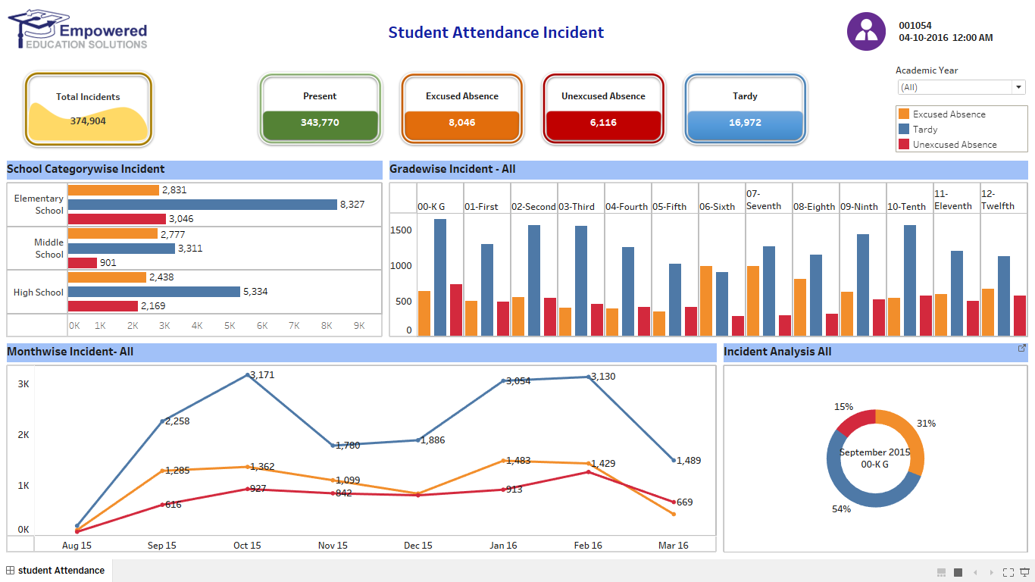
Visual Dashboard – Empowered Solutions

Slide 19
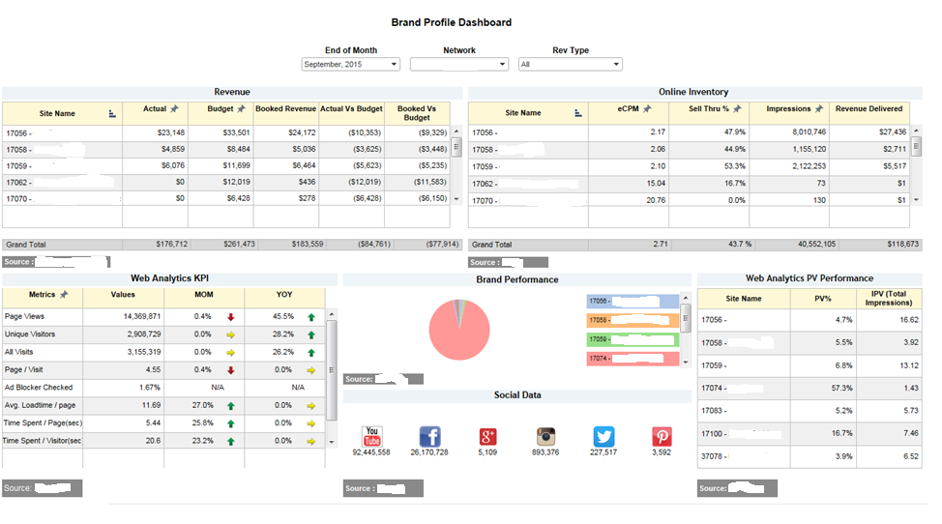
Visualization - Brand Profile Dashboard for TEN
Major magazine publishing house focusing on auto industry

Slide 20
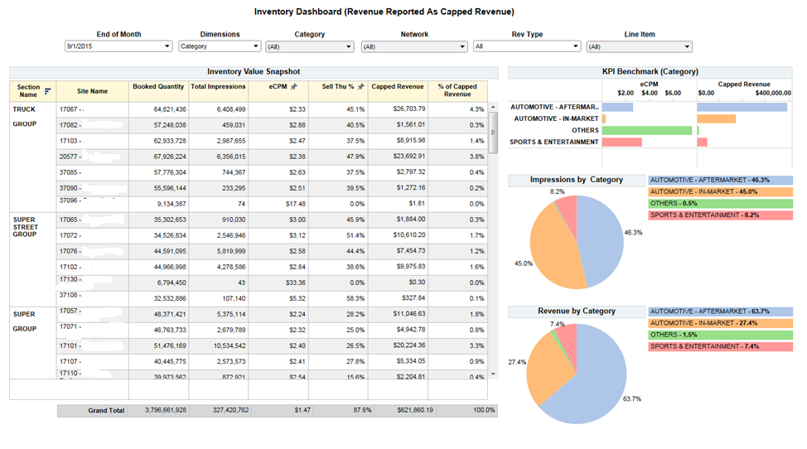
Visualization - Inventory Dashboard for TEN

Slide 21
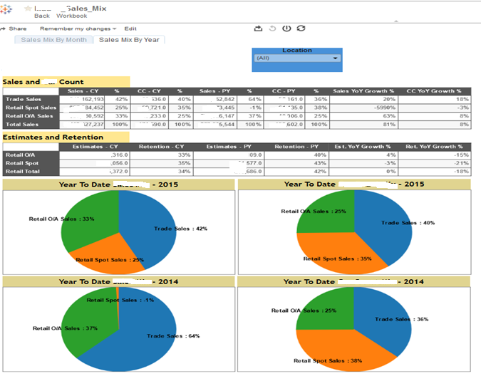
Visualization - Sales Mix by Year for Audatex

Slide 22
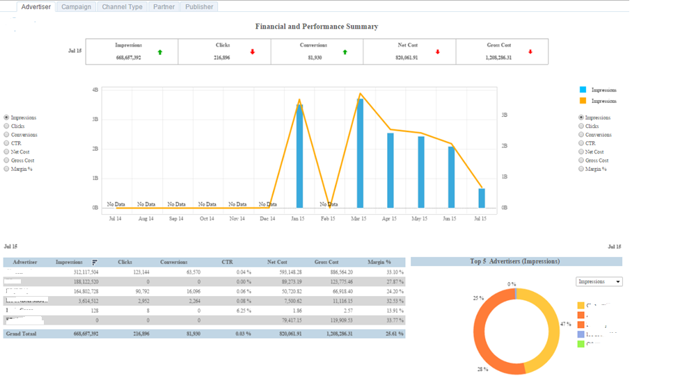
Visualization - Performance Summary for Advertiser for Fusion Seven

Slide 23
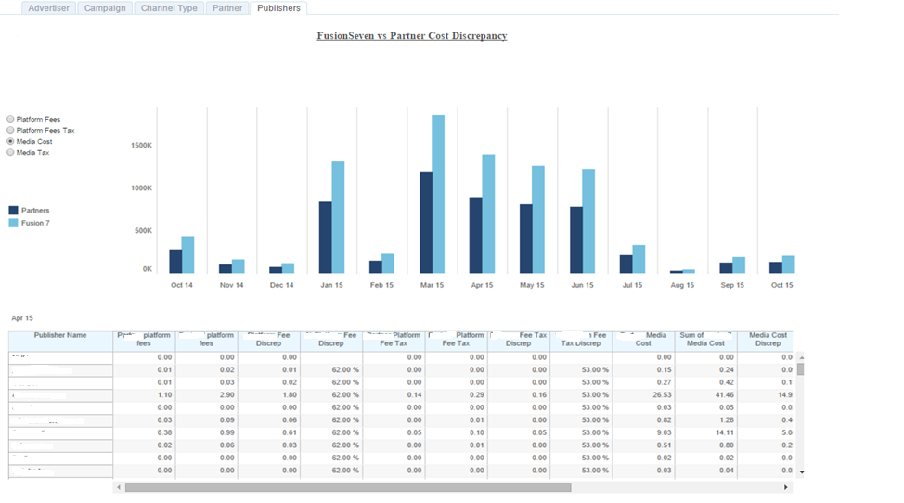
Visualization - Partner Cost Discrepancy for Advertiser – Fusion Seven -

Slide 24

Big Data - Web Analytics for TEN
Challenges
360 degree view of the customer to help serve them better and generate revenue in the process.
Associate like-minded people with similar tastes visiting over 80 websites of special interest media for enthusiast communities interested in automotive, action sports, magazine sales and Logistics Company
Organize articles and blogs, images, and videos into groups of similar items
Building a data warehouse that has zero knowledge about collaborative filtering, articles and blogs clustering, semantic analysis, thereby providing recommendations to users by grouping articles together.
Solution Provided
Layered architecture for flexibility and scalability of weblog data collection and information dissemination
Used big-data open-source technologies such as Hadoop, Pig, and Sqoop to handle the scale [Cloudera and AWS distribution]
Created Collaborative Filtering (CF) recommendation using Machine Learning algorithm Mahout
Workflow orchestration using Oozie
Data collected from weblogs of all websites using Apache Flume, without impacting the throughput
Improved articles and blogs clustering/grouping using Semantic Analysis
Generated Login flows through Social network API’s (OAuth 2.0)
Controlled traffic and browsing patterns, improved time spent and unique visitors from within and outside of the network of 80+ site suite
AWS Cloud based solutions helps to implement recommendations with no turnaround time for any site and monitor site traffic immediately. This in-turn reduces the cost and improves ROI.
About the Client
Major magazine publishing house focusing on auto industry
Technology Used
Operating System - Windows7, Linux
Languages - jdk1.6, Cloudera eco-system, pig latin script, SSIS
Tools - eclipse3.6 development kid
RDBMS - MS SQL 2008R2
Nosql database - Mongo DB
Graph database – Neo4J
Analytics and Reporting – Tibco spotfire
Deployment – AWS – Elastic cloud, EMR & EC2 clustered environment
Notes:
Bring in SAS, Tableau and other analytics case studies

Slide 25
Big Data – Real Time Stream Processing for Altice (Formerly Cablevision)
Customer
Major communication and cable television provider
Owns and manages physical network communication infrastructure, WiFi networks etc.
Massive amount of data generated everyday, from customers and infrastructure.
Benefits and Highlights
Improve customer complaint resolution speed and productivity gain leading to improved customer satisfaction and retention
Challenges
Customer call center is the central hub for customer service and is responsible for the vast majority of
consumer interactions and service-related transactions.
The customer service touch points—such as resolving a complaint, taking an order, renewing a warranty or up-selling a product—are pivotal in accomplishing strategic business objectives.
Proactively deliver messages / information to customer, thereby reducing call center resource usage and improve customer engagement.
Manage massive data flow from disparate systems, including but not limited to some of the following:
Network systems such as routers, switches, boosters, splitters etc.
Customer facing websites
IVR call system calls and ticketing data
Set-top box data
Secure customer data and maintain industry compliance such as SOX and Media compliance.
Proactive infrastructure monitoring and alerting leading to optimal use of system resources
Introduced unified lambda architecture platform that manages both streaming real time data and batched data
Linearly scalable systems architecture with proactive operational and business monitoring and alerts

Slide 26
MIGRATING FROM ENTERPRISE WAREHOUSE TO BIGDATA AUDIENCE MEASUREMENT
Benefits and Highlights
Challenges
Streamlined and unified lambda architecture platform that manages both streaming real time data and batched data
Overtaxed existing infrastructure that does not scale gracefully.
Upgrade existing warehouse systems to a more sustainable, economically viable and horizontally scalable platform.
Manage data flow from disparate systems, including but not limited to some of the following:
Set-top box data (Primary source, streaming).
Network systems such as routers, switches, boosters, splitters etc. (batch)
Customer facing websites. (streaming)
IVR call system calls. (streaming)
External feeds (batch)
Ticketing system etc. (streaming)
Multiple tools, layers and technologies on existing system, all typically grown through evolutionary architecture
Linearly scalable systems architecture with proactive operational and business monitoring and alerts
Major cost savings by retiring multiple disparate systems and licenses
Shared storage and compute environment across different business divisions
Secure data storage and role based access

Slide 27

Big Data – Enterprise Data Lake for Altice (Formerly Cablevision)
Challenges
Hadoop cluster conceptualization, design, implementation and maintenance
Migration from existing traditional DWH (Netezza) environment to Hadoop environment. From Data to Process to Job. This effort was to support growing data for Audience Measurement analytics.
Creation of centralized data ingestion platform (EPN), that is able to scale to 150k events / second, as well as serve as a platform for batch ingest & processing.
.
Solution provided
Evangelize, analyze, conceptualize, design and setup of big data environment.
Planning and migration of data and jobs from enterprise data-warehouse platform (Netezza) to Hadoop ecosystem (Pivotal XD HAWQ)
Integration with platform for centralized data collection and aggregation at scale in near real time from varied sources and formats. This layer is known as EPN (Event Processing Network)
The first tow applications that went live using this were E2E (End to End Ticketing System) for CRM and Outage communication
Technology Used
Operating System - RHEL
Platform – Pivotal XD Hadoop, Pivotal Hawq, MapR, Data virtualization (Denodo/Cisco)
Ingest tools – Storm, Spring XD
In-memory systems – Redis, Kafka
Languages - Java, Shell, Python, pig latin script, SQL
Databases – HBase, Pivotal HAWQ, Netezza
Analytics, aggregation and Reporting – Storm, Hawq, Microstrategy
Deployment – In house data center with AWS DR (POC)

Slide 28
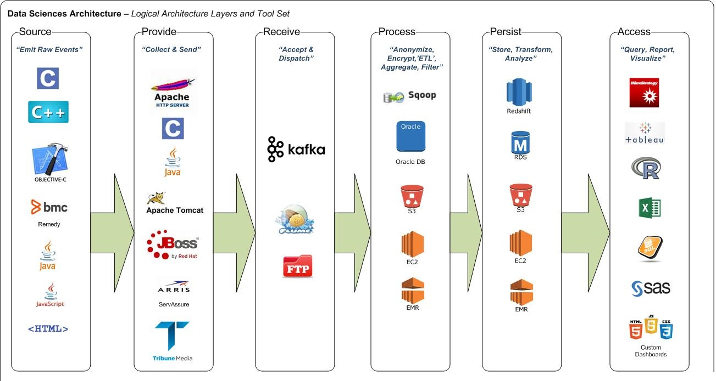
Big Data Technologies - Altice (Formerly Cablevision)

Slide 29
Inferential Analysis and Predictive Analytics – Battery Manufacturer
1
Business Discovery
Identification of critical variables and data trails through constant engagement with Midtronics business teams.
2
Inferential studies and Feature Engineering
Trend analysis of variables over time from the perspective of SOH and SOC of batteries
Inter-relationship between variables.
Adequacy and sufficiency of available variables
Feature engineering of variables.
3
Model building and deployment¹
Classification Models :
Model Selection and training( From LR, SVM, NB, RF etc.)
Model fine tuning
Baseline metrics
Model deployment
Predict battery failures.
SOH : State of health, SOC : State of Charge , LR : Logistic Regression, SVM : Support Vector Machine, NB : Naïve Bayes , RF : Random Forest

Slide 30
Inferential Analysis and Predictive Analytics for School District, TX
1
Business Discovery
Derive key business drivers and influencing factors
2
Trends of key variables across schools and causal analysis
Inter relationship between variables
Feature engineering which includes
Transformation of existing features
Introducing new features
Inferential studies and Feature Engineering
3
Model building and deployment¹
Model Selection ( From suitable classification/ regression models.)
Training the model
Model fine tuning
Baseline metrics
Model deployment onto existing product
Predict potential student drop out. Inferential studies on factors affecting achievement

Slide 31


